Slide 1

AWS Systems Operations 21 May 2019 Fernando Pombeiro

Slide 2
Cloudwatch

Slide 3
Infrastructure philosophy
Logging and bug hunting is essential to any stack. One of the biggest advantages of using AWS for deploying and maintaining infrastructure is that logging is built in to the AWS infrastructure.
This built in logging is known as cloudwatch and can be provisioned and utilized and managed via terraform.

Slide 4
Cloudwatch in terraform
Go into your aws console and take a look at some of our previously deployed resources- specifically the EC2 webserver instance that we deployed
Go down to the bottom of the screen and look at the Monitoring tab. You should see a bunch of charts there that demonstrate everything from CPU Utilization to Network IN, Disk Reads and Disk Writes, and Packets.

Slide 5
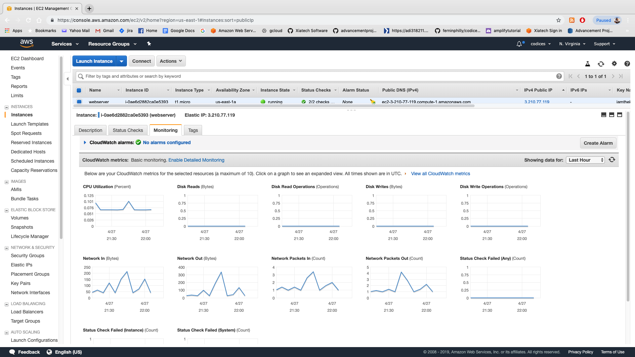
Cloudwatch (continued)

Slide 6
Cloudwatch (continued)
Note that you can look at different time ranges.
BUT- cloudwatch is MUCH more than just charts! You can also use cloudwatch to log issues sent to STDOUT and STDERR from an application.
So we can read items sent from console.log, print, Printf, etc… to the log. We can also filter these items. In the lab we’ll be deploying an application that does nothing but print out items.

Slide 7
Cloudwatch logs (continued)

Slide 8
Cloudwatch Logs
Cloudwatch logging should be the first place your developers go when they are looking for issues.
Speaking from personal experience- I’d recommend having your dev team log out to stdout frequently to keep track of the flow of the application.
All STDOUT errors and stack traces will also appear in cloudwatch logs- which you can have devs look at directly or forward directly to them.
Finally- SYSTEM logs (what DEVOPS are interested in) and APPLICATION logs are different.

Slide 9
Cloudtrail agent
So- along with cloudwatch at the application level there is also an add-on known as cloudtrail which is basically cloudwatch but on the AWS account level.
Every event that occurs on your AWS account (provision an EC2 instance, log in to the console, etc…) can be sent as a log to an S3 bucket where you can then access it through an api interface.
This is a good thing for the senior sys-ops personnel to use to monitor use (and costs) of AWS resources.

Slide 10
Cloudwatch trail (completion)
Although cloudtrail is outside of the scope of deploying and managing applications it’s worth studying up on if you are the senior sys-ops.
AWS costs get out of control pretty quickly and from personal experience I’d suggest setting up cloudwatch alarms for certain activities (like creating Redshift instances at $150 per month a pop) and DynamoDB tables ($5k a pop).

Slide 11
Cloudwatch Alarms
Another advantage of cloudwatch is that we can set up alarms in AWS that will notify the team when certain activities occur in an application.
In the example of a web application we can set up alarms that notify us if there are more than three 404 errors in 5 minutes or a system overload or anything like that.

Slide 12
Cloudwatch Alarms (continued)
You can set cloudwatch alarms with text recognition to notify a person or group depending on the type of text that comes in on the logs (we’ll be doing this in the upcoming lab).
This allows us the flexibility to customize the alarm depending on the error handling being used by your coders.

Slide 13
Cloudwatch alarms and SS
So- while cloudwatch alarms will notify you as to what is happening…the next logical question is “notify WHO?...and HOW?”.
The answer to this is another AWS service that we can use for multiple resources: the AWS Simple Notification Service.
SNS can be used for notifications from most services but in this case we’ll be hooking it up to cloudformation.

Slide 14
Simple Notification Service

Slide 15
PUB/SUB
So the AWS Simple Notification Service is basically a publish/subscribe (pub/sub) service in AWS.
The service can send messages between various AWS resources based on the existence of an event. This makes it a key component of event driven architecture.
Although we’ll be utilizing SNS to send messages based on cloudformation events… this is just ONE of the events we can use to trigger messages.

Slide 16
Simple Notification Service

Slide 17
SNS Topics
SNS publishes messages to TOPICS- which are what the client subscribes to.
So we’ll set up a TOPIC based on each type of cloudwatch alarm we want to create (for example “404 errors” or something.

Slide 18
SNS Broader context
So TOPICS can be used for multiple triggers in your AWS infrastructure. Think of SNS as the glue that holds all of the microservices in your infrastructure together: it’s a convenient way to pass messages between resources and ensure that you retain your event driven architecture.
In the lab we’re going to create a topic to send an email and text message based on a string pattern in cloudwatch.

Slide 19
Lambdas

Slide 20
Serverless applications
So if SNS is the pub/sub glue that holds our serverless application together then LAMBDAS are the functional portion of our application.
Think of Lambdas as small code repositories that do one very specific job for you without you having to worry about server management or deployment.
Lambdas are an incredibly powerful tool that can do anything from create APIs to transform data mid-stream.

Slide 21
Lambdas
So a lambda function is essentially a container (a lot like the Docker container we built in lab one) that is built and runs on any spare resources by AWS.
AWS manages finding the resources, provisioning the container, and running it.
The other thing to know about LAMBDAS is that, due to the nature of containers, they are designed to be ephemeral. This means that we want them to DO A THING then commit seppuku.

Slide 22
Lambdas and triggers
Lambdas are a key component of any event driven architecture. You can have them run based on lambda triggers which are basically an event that occurs that sets off your lambda.
This event can be anything from adding data to an s3 bucket to receiving a message that we are subscribed to on an sns topic to consuming a queue from a Kinesis stream.

Slide 23
Event driven architecture and Lambdas
SO- like everything else in AWS- Lambdas need to exist within a VPC and have cloudwatch logs attached.
The ideal scenario for your architecture is that you create lambdas to do transformations on your data (or put data in to or take data out of a database) that run on triggers from other events passed through SNS.
This allows you to save managing large machines to make up complex architectures.

Slide 24
Kinesis

Slide 25
Streaming Data in AWS
So as a hypothetical- let’s say we have a situation where data is coming in at an insanely fast rate…something like a twitter stream or sports odds stream.
We want to create a system to consume this data, make some changes (to standardize the inputs) and then put the data into our previously created RDS instance.

Slide 26
Stream Data
The advantages of using queues in this situation is that we can keep the data in order and, in the event that our consumers slow down or fail, we can keep a copy of the data in a pre-database system.
This will allow us time to spin up more instances if a consumer or two get overloaded by high velocity data going through the stream. This is a solid safety measure for data integrity.
Additionally streams can provide endpoints that can trigger events.

Slide 27
Kinesis stream architecture

Slide 28
Kinesis streams conceptually
So a basic unit of scale when dealing with Kinesis streams is about 1,000 PUTS per second of streaming data and emitting data at a rate of 2MB per second. This is a single shard.
Shards scale linearly (2 shards = 2,000 puts, etc)
Data is saved, by default, up to 24 hours (though you can pay to have it saved for up to 7 days)
You can monitor streams through cloudwatch.

Slide 29
Kinesis Firehose
Kinesis Firehose is the term used to refer to Kinesis services that stream between two AWS resources.
An example of this might be a Kinesis stream that takes in data and sends it to a redshift database or s3 bucket (which is actually really nice- you can send a JSON object to REDSHIFT and, provided that the keys match column names, can PUT data into tables).

Slide 30
SQS vs SNS
AWS offers a second option for message queuing: the Simple Queue Service which is a messaging broker (that looks a lot like the Simple Notification Service).
The difference between SQS and SNS is simple:
SNS is a PUBSUB system- it pushes messages to receivers in order for them to do something. The receivers subscribe to a topic and when a message is published they receive it in near real time.
SQS is a Message Broker: consumers need to POLL it to get messages from it and you can’t send the messages to multiple receivers. It’s basically a mailbox- message in and message out.

Slide 31
SQS and Kinesis
As Kinesis and SQS are both message brokers we should comment on the (subtle) differences between them:
The biggest difference is that SQS is a FIFO (First IN First OUT) queue whereas KINESIS is intended for real time data processing…so, as the name implies- it’s really intended for a stream of data
Think of the difference you get from, say, an HTTP call versus a websocket connection stream: for an HTTP call it’s probably better to use SQS but if you are opening up a websocket connection you want a kinesis stream.

Slide 32
Database Sources

Slide 33
Databases available in AWS
So there are numerous options available for data storage in AWS. As pointed out earlier: fundamentally we’ll want to deal with s3 buckets as a permanent data store.
Try to, if you can, keep copies of all of the incoming data in gzipped files in s3 buckets based on a directory structure that you like
Kinesis and SQS have libraries that will add unique IDs and store data in a directory structure with YEAR/MONTH/DAY/HOUR

Slide 34
How to think about choosing databases
The idea behind AWS data storage tools is to save you the trouble of having to manage servers that would normally run your instances.
AWS offers a lot of awesome options for your back end: In the SQL end you can choose between
MySQL
Postgres
Redshift
Aurora (think Mysql)

Slide 35
NoSQL solutions
So for interim solutions for fast moving data (think websocket streams) it is frequently a good idea to have some way to do in-stream data transformations in near-real time. Think of things like kafka (which, interestingly enough, is also available in AWS now!)
NOSQL solutions tend to be ideal for this and AWS offers a nice one known as DynamoDB to handle these streams.

Slide 36
DynamoDB- managed NOSQL solution
So Dynamodb saves your data as JSON objects- which is especially useful when dealing with things like node.js applications.
You also get a nice interface:

Slide 37
DynamoDB and streaming
Two more nice things to note about Dynamo:
It can handle streaming data nicely from Kinesis and you can make “in-stream” transformations (for instance changing a “raw event” to a structured bit of data in Lambda then storing it in Dynamo
It saves “before and after” images of any data transformed on a specific key…which is a nice way to log any changes on data going into your database (so if you need to “replay” an ingestion it’s a nice thing to have!

Slide 38
DynamoDB
Think of DynamoDB as an excellent stop off and transformation opportunity for incoming data from a stream.
You CAN use it as a permanent data store but it’s not advisable as dynamo can be VERY expensive (if you DO use it use a ttl with the data).

Slide 39
Redshift
REDSHIFT is an excellent permanent analytic datastore. It’s SQL based and works on POSTGRES syntax (which means that you can use windowed functions, etc)
It is a columnar stored database that is capable of being scaled up to terrabytes and integrates with the AWS s3 buckets to form a nice endpoint to a datalake.

Slide 40
AWS RDS Service
Outside of Redshift you have the options for AWS Relational Database Services that work with any of your favorite services:
MYSQL
Postgres
MariaDB (Mysql)
Oracle
SQL Server
The idea here is that you can choose whatever db you are most comfortable with and use that one for your app.

Slide 41
Server Options

Slide 42
EC2 instances
The go to servers in AWS are known as EC2 instances. Just like everything else they come in multiple flavours depending on what you are comfortable with:
Amazon Linux
Red Hat Enterprise Linux (CentOS)
Suse Linux
Ubuntu
Windows

Slide 43
Elastic Block Store
One of the big advantages of utilizing EC2 in AWS is the availability of Elastic Block Store- which is basically a storage volume that you can attach to EC2 instances.
You can take snapshots of EBS volumes into S3 thus providing reliability that you can’t get anywhere else.
This is useful if you’re getting a data stream writing data to a local drive (so a local file system)

Slide 44
Elastic Block Store continued
So Volumes in EBS are a fantastic way to persist data beyond the life of an ec2 instance.
The idea is that you would mount the volume and use the directory for anything that requires high velocity throughput (read/writes, etc). The files in this mounted directory would be rapidly changing.
The advantage of using a mounted volume here would be that you get snapshots sent to s3 therefore if there is an error you can roll back to a previous state.

Slide 45
Elastic Block Store
If you’ve ever dealt with a situation where you needed a highly-available database structure with multiple nodes then hopefully you see how useful EBS blocks can be for storing data.
Although they can only be attached to one instance at a time they make a powerful persistent store for data on EC2.

Slide 46
Confused????
GOOD! Ask Questions!!

